Slide 1
Elephant Herding Optimization
The algorithm and its Python implementation
A Rastrigin benchmark and a simulated two-pump application
Notes:
Meena, Yang and Slowik, Elephant Herding Optimization, Chapter 12, pp. 149–162. The Python project follows Algorithm 11 and Listings 12.1–12.2.

Slide 2
Candidates and fitness
Each candidate is a row of numbers. The objective function gives that row a fitness score, and the algorithm searches for a lower score.
Rastrigin has many local minima. Its best possible fitness is zero at the origin.
The population changes at each generation. The optimizer also saves the best position it has found across all generations.
Notes:
Meena, Yang and Slowik, Elephant Herding Optimization, Chapter 12, pp. 149–162. Sections 12.2 and 12.5. In Python, every matrix row is a candidate.

Slide 3
The three position updates
Regular candidate
Move each coordinate toward the best position saved so far. Alpha and a random draw control the step.
Leader row
Average the old positions coordinate by coordinate, then multiply the center by beta.
Worst candidate
Sample a new position using the bounds. The +1 in Equation (12.4) can put a coordinate above its upper bound.
Notes:
Meena, Yang and Slowik, Elephant Herding Optimization, Chapter 12, pp. 149–162. Equations (12.1)–(12.4). Regular steps draw r per coordinate. Python uses the older population for all updates and follows the listing’s leader precedence.

Slide 4
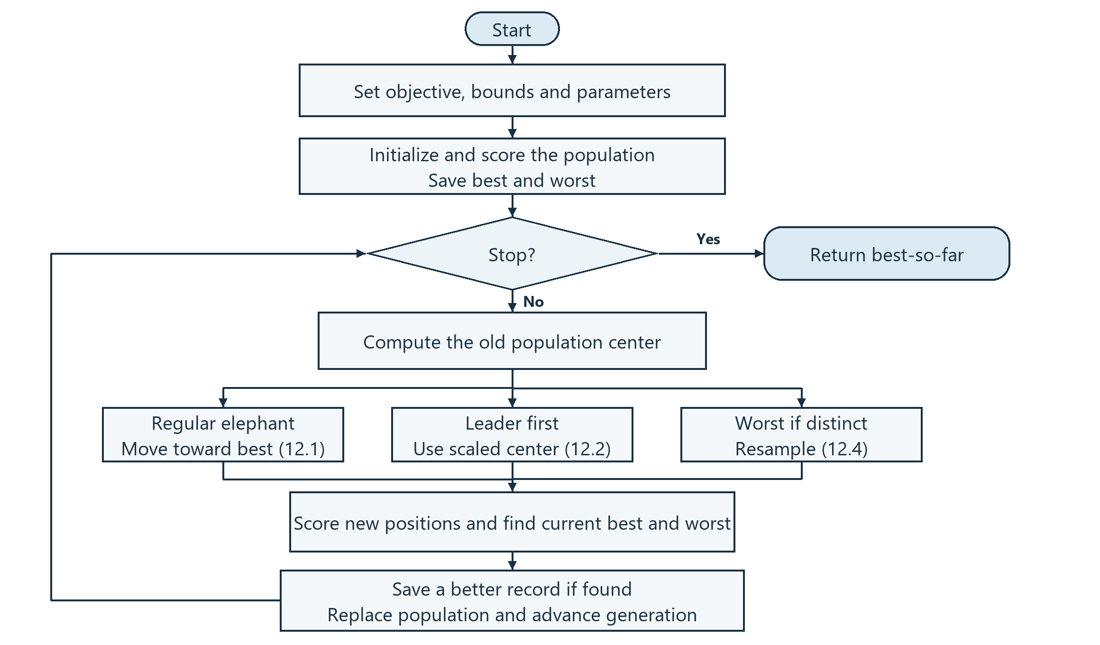
Block flow and Python code
optimizer.py
Runs the loop and saves the best score and position.
operators.py
Computes the center and applies the three update rules.
Notes:
Meena, Yang and Slowik, Elephant Herding Optimization, Chapter 12, pp. 149–162. Algorithm 11 and Listings 12.1–12.2. The loop evaluates each new population, updates the best record only on improvement, and keeps the leader index tied to that record.

Slide 5
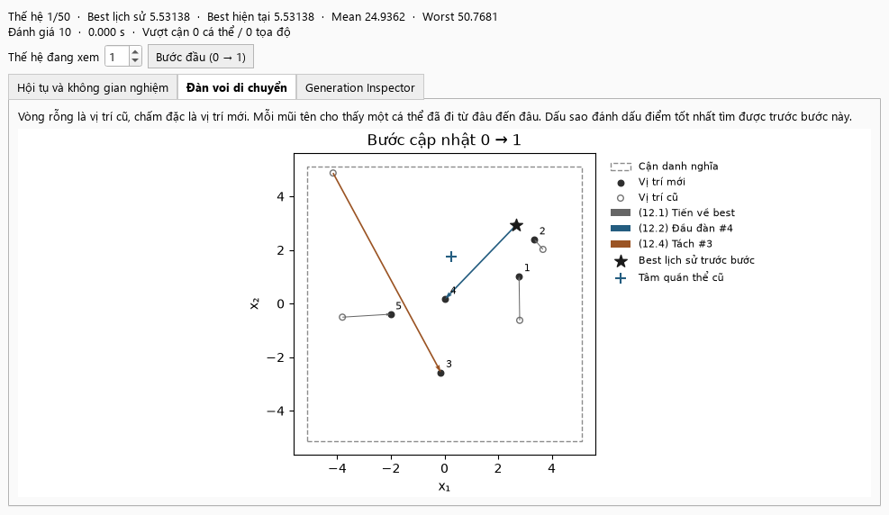
Rastrigin demo
Generation 0 → 1
Open circles mark old positions. Solid dots mark the new positions.
After 50 generations, the best score fell from 31.2939 to 0.00937.
Notes:
Meena, Yang and Slowik, Elephant Herding Optimization, Chapter 12, pp. 149–162. Section 12.5 and Equation (12.5). Actual offscreen GUI run, seed 42, five candidates, 50 generations, alpha 0.5 and beta 0.1.

Slide 6
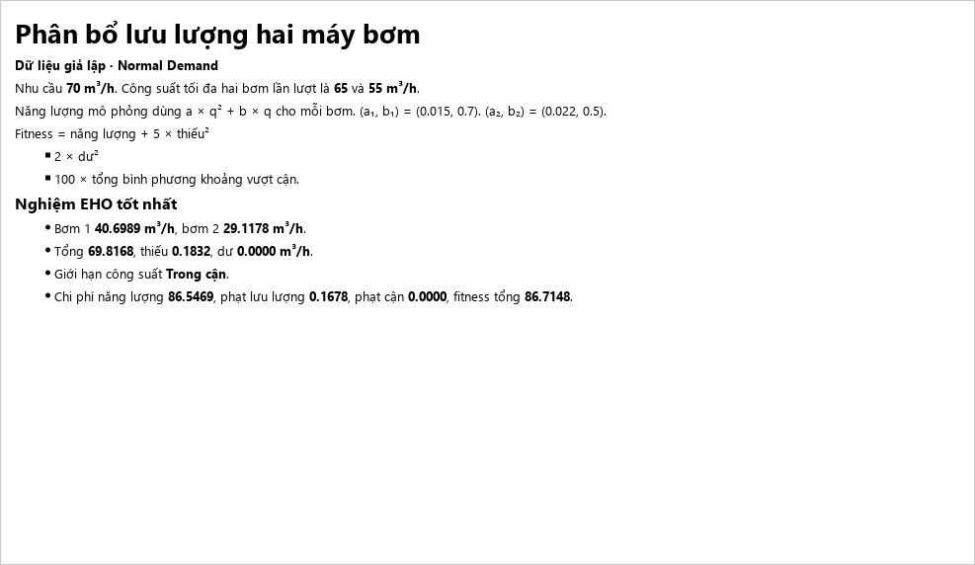
Two-pump flow allocation
70 m³/h target
The candidate contains one flow rate per pump. Fitness adds operating cost and penalties for flow mismatch and capacity violations.
The demo supplied 69.82 m³/h within the individual pump limits. Fitness was 86.7148.
Notes:
Project application. See Experiment/Experiment 4.ipynb, data/pump_scenarios.csv and src/objectives/pump_allocation.py. The grid score was 86.5969 using 81 × 81 points. The input data are simulated.

